Slide 1
Magnetic Reconnection

Slide 2
What is magnetic reconnection?

Slide 3
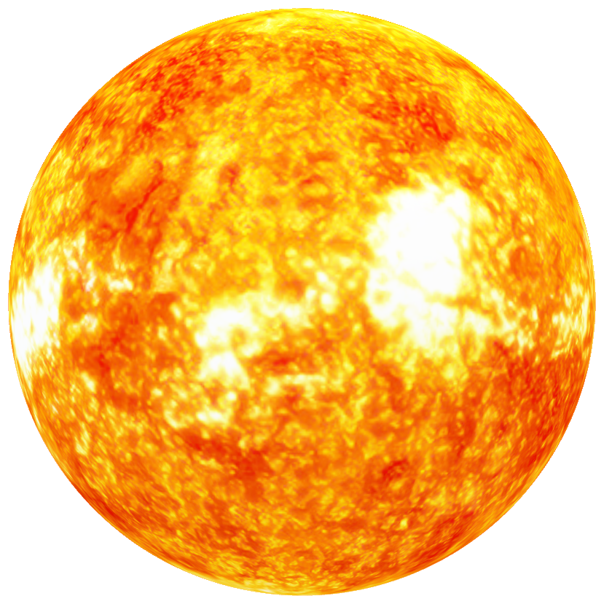
SUN’S MAGNETIC FIELD
SUN’S MAGNETIC FIELD
SUN’S MAGNETIC FIELD

Slide 4
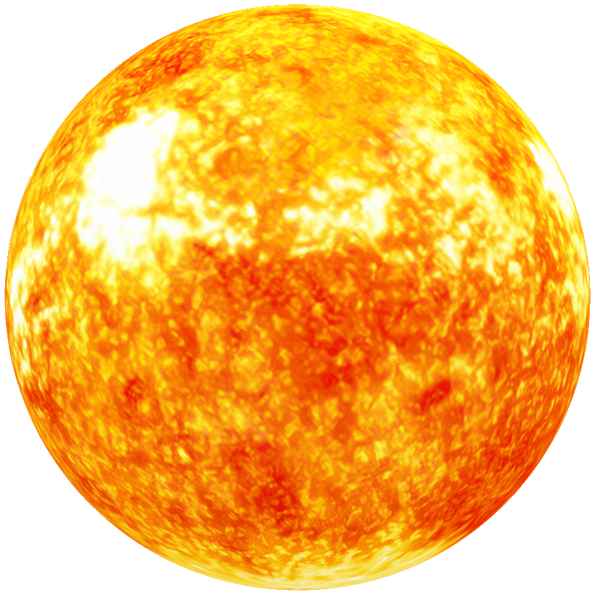
SUN’S MAGNETIC FIELD
SUN’S MAGNETIC FIELD
SUN’S MAGNETIC FIELD

Slide 5
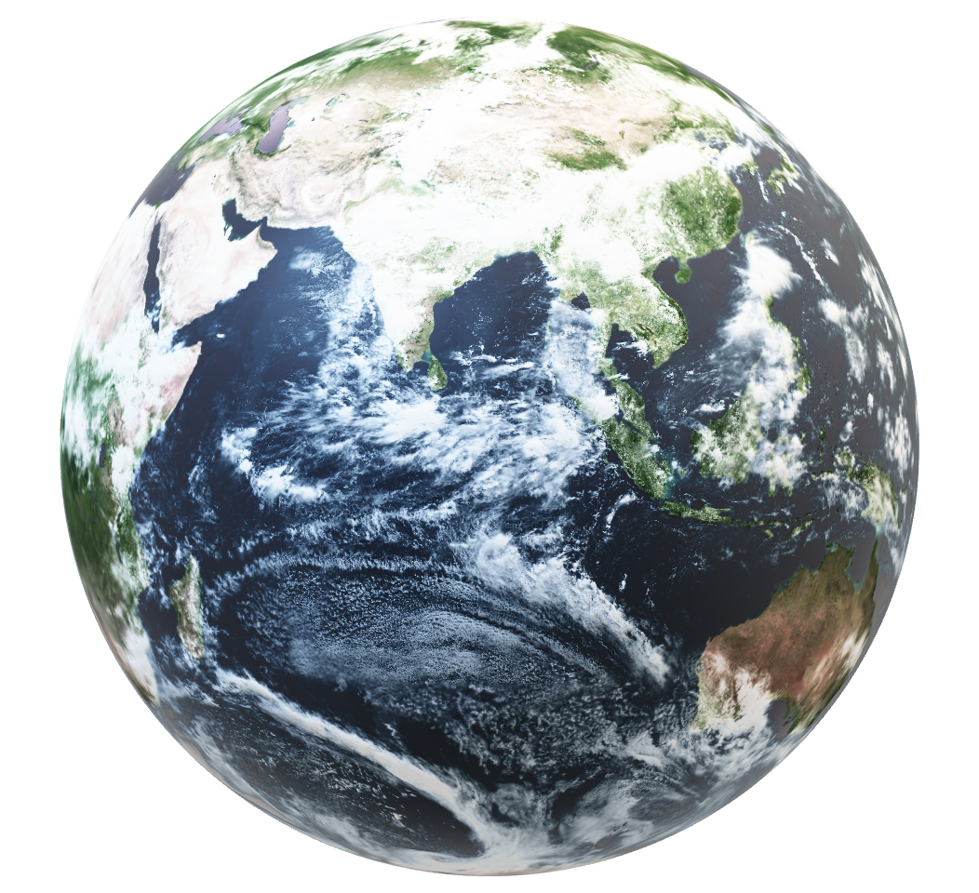
EARTH’S MAGNETIC FIELD
EARTH’S MAGNETIC FIELD
EARTH’S MAGNETIC FIELD

Slide 6
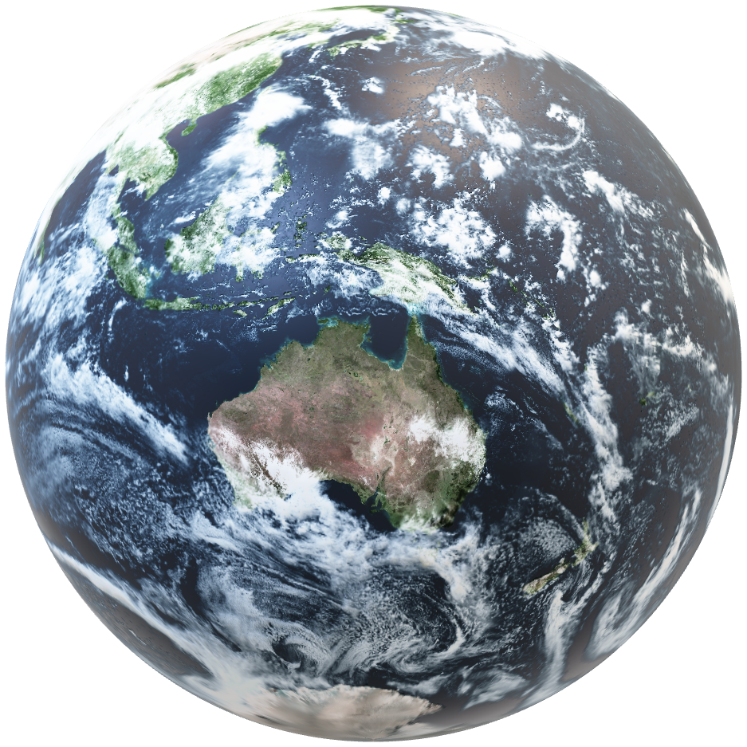
EARTH’S MAGNETIC FIELD
EARTH’S MAGNETIC FIELD
EARTH’S MAGNETIC FIELD

Slide 7
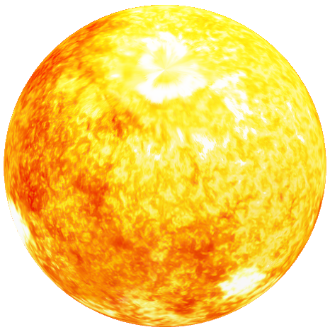
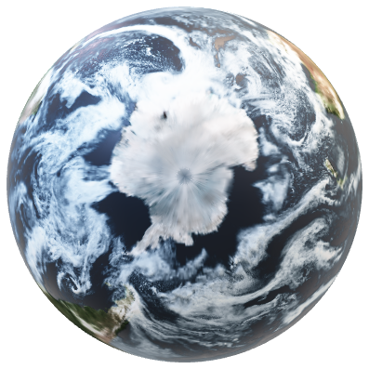
Why is it a problem?
Why is it a problem?
Why is it a problem?

Slide 8
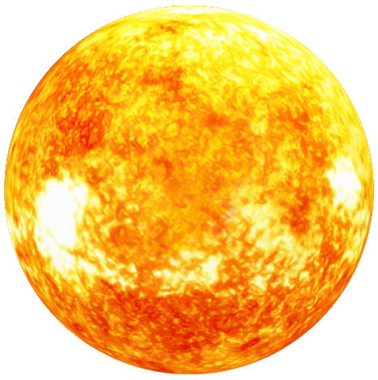
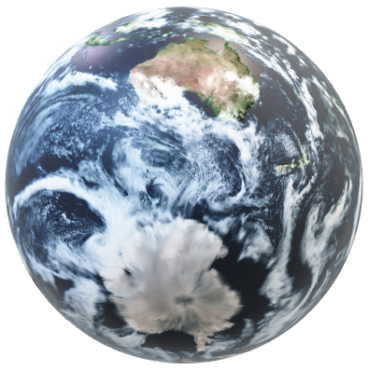
Why is it a problem?
Why is it a problem?
Why is it a problem?

Slide 9
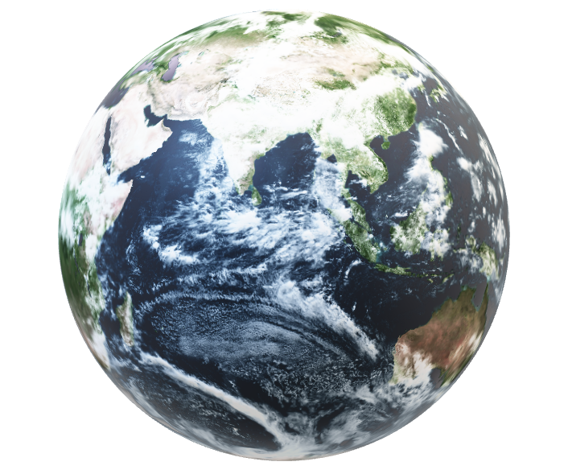
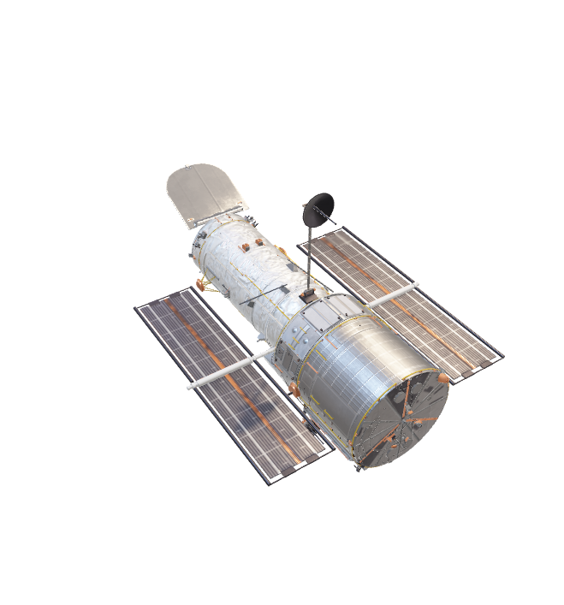
Who does it affect?
Who does it affect?
Who does it affect?

Slide 10
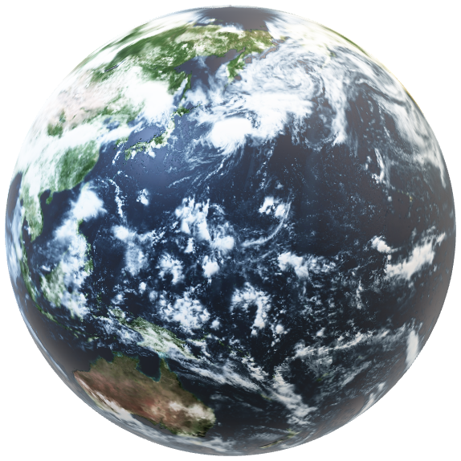
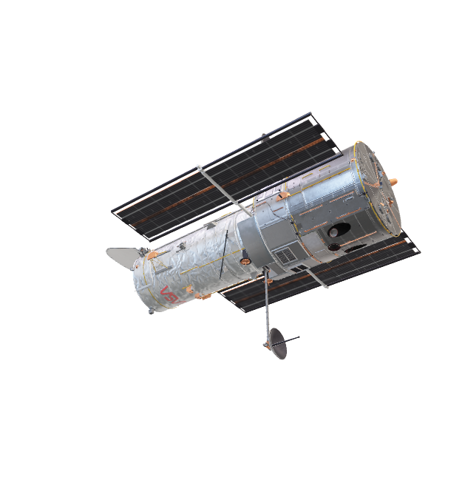
Who does it affect?
Who does it affect?
Who does it affect?

Slide 11
Our solution

Slide 12

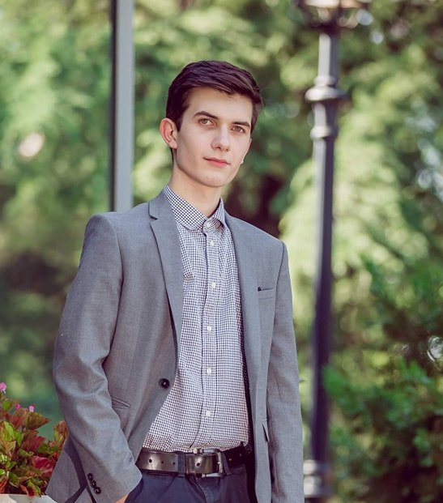


Team
Lizi Chkheidze
Nikoloz Robakidze
Ana Svianadze
Magamed Guseinovi

Slide 13
Thanks for attention!

